Slide 1
A Minimal Over-Collateralized Stablecoin Protocol
ETH-collateralized vault + STB mint/repay/withdraw
Oracle validation (Chainlink spot + TWAP + breaker)
Keeper-based liquidation + bad debt accounting
Full stack: Contracts + Backend indexer/API + Frontend
Yanqi Yang

Slide 2
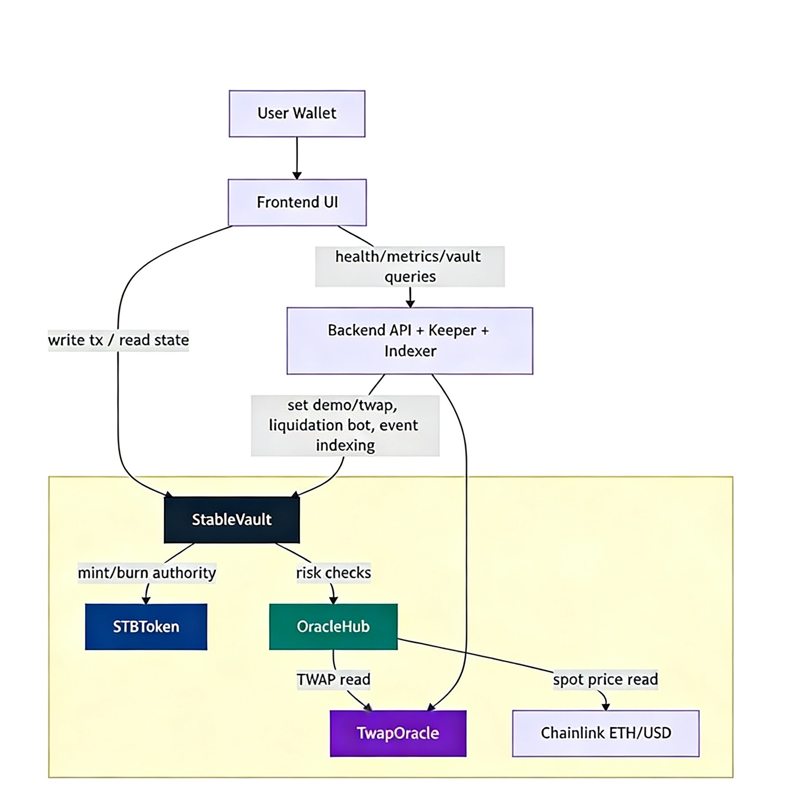
StableVault: core vault logic, risk checks, liquidation, bad debt
STBToken: vault-authorized mint/burn token
OracleHub: spot+TWAP validation and breaker
TwapOracle: publisher-updated TWAP feed
TRADE OFF:
Prioritized clarity/safety over maximal feature scope
Added demo mode for deterministic liquidation demos
Keeper automation in backend for operational simplicity

Slide 3
CHALLENGE SOLVED：
Prevent unsafe operations during unreliable oracle conditions.
Implementation highlights
OracleHub.getPriceStatus()： checks staleness + deviation.
StableVault：blocks risky actions when breaker triggers.
nonReentrant+ CEI ordering for sensitive functions.
Pause switch for critical operation control.
canRiskActionProceed()： check before mint/withdraw/liquidate
nonReentrant： on mutation paths
Gas tests + Slither analysis integrated into workflow.

Slide 4
RESULT AND LEARNING
What worked well
End-to-end flow works across contracts/backend/frontend.
Automated tests: contract + frontend coverage workflow.
Clear demo path for liquidation and bad debt behavior.
What we would improve
Higher branch coverage, especially frontend edge paths.
More automation for env/address propagation after deploy.
Stronger observability and multi-keeper robustness.
Key learnings
Risk controls must be testable, not just implemented.
Full-stack protocol demos require tight env consistency.
Security tooling (tests + static analysis) should be continuous.

